Slide 1
1
AWS AGENTIC AI HACKATHON — FUTURE VISION | AWS SUMMIT DUBAI 2026
SHIFA
Idea Track: Health Companion — the right door, not a diagnosis
Kyaw Sithu — PEGB
Hiten— Translab
Ye Yint Myint Aung— SP
Manav — Crypto
AWS Agentic AI Hackathon — Future Vision | AWS Summit Dubai 2026
Notes:
Slide 1, Title. 10 seconds. Running total 0:10.
Good afternoon, judges.
We are Shifa, and we tackled the Health Companion track.
(Pause)
I am Kyaw Sithu, and with me are [names].
Let me show you the problem we are solving.

Slide 2

1
Probem Statement
Healthcare doesn't fail people at the diagnosis. It fails them before it: not knowing where to go, and drowning in calls and forms to get there. Symptom checkers try to be doctors. We built the opposite: a navigator that never diagnoses, but gets you to the right door and does the paperwork for you.
Confused on which specialist to see or book? Tired of filling out forms, taking calls and going to the hospital and queuing aimlessly? SHIFA will make all that disappear
AWS Agentic AI Hackathon — Future Vision | AWS Summit Dubai 2026
Notes:
Slide 1, Title. 10 seconds. Running total 0:10.
Good afternoon, judges.
We are Shifa, and we tackled the Health Companion track.
(Pause)
I am Kyaw Sithu, and with me are [names].
Let me show you the problem we are solving.

Slide 3

THE PROBLEM
⭐ 30% — CUSTOMER IMPACT
2
Meet Aisha Rahman, 41
School teacher in Sharjah, mother of two, lives with high blood pressure
🩺
Three days of headache and blurry vision between classes. Wait, see a doctor, or rush to the ER? Every option means phone calls, repeating her history and allergies, and insurance forms.
Wait it out?
See a doctor?
Go to the ER?
One conversation → the right door
Triage, booking and insurer call handled by the agent, in minutes
AWS Agentic AI Hackathon — Future Vision | AWS Summit Dubai 2026
Notes:
Slide 2, The Problem. 30 seconds. Running total 0:40.
Meet Aisha. She is 41, a school teacher in Sharjah and a mother of two.
(Pause)
She lives with high blood pressure and takes amlodipine.
For three days she has had a headache and blurry vision.
Should she wait? See a doctor? Go to the ER? (Key Point)
Symptom checkers try to diagnose her. Nobody books anything. And every step is another phone call to a clinic or her insurer.
With Health Companion, one conversation gets her to the right door. (Key Point)
(Pause, let it land)

Slide 4
OUR SOLUTION
✨ 20% — INNOVATION
3
Health Companion by Shifa
An AI care navigator that turns one message or call into a triaged, pre-filled, booked visit — in Arabic or English, and never a diagnosis.
01
▶
Reads the uploaded Emirates ID and pre-fills government (UAE PASS; Absher in KSA) and insurer forms
02
▶
Pre-fills the hospital intake form from the chat or call: symptoms, allergies, medications, preferences
03
▶
Triages with the Knowledge Base; red flags or unknown, mismatched symptoms → emergency services now
04
▶
Checks eligibility, flags missing documents, submits the booking and insurer pre-approval
05
▶
Monitors status and updates the patient by WhatsApp, SMS or email — whichever they prefer
⚡ This is an AGENT that takes action — not a chatbot that answers questions
AWS Agentic AI Hackathon — Future Vision | AWS Summit Dubai 2026
Notes:
Slide 3, Our Solution. 45 seconds. Running total 1:25.
We built Health Companion.
In one sentence: one message or one call becomes a triaged, pre-filled, booked visit. (Key Point)
Step 1, the patient uploads their Emirates ID once. The agent extracts the data and pre-fills government and insurer forms.
Step 2, from the chat or call it fills the hospital intake form: symptoms, allergies, medications and preferences. The doctor reviews instead of re-asking.
Step 3, it triages against our Knowledge Base. Red flags, or symptoms that are unknown or don't match her history, go straight to emergency services. This part is live.
Step 4, it checks eligibility, flags missing documents and submits the booking and pre-approval. Today our voice agent already calls clinics and insurers.
Step 5, it monitors the status and updates her by WhatsApp, SMS or email, whichever she prefers.
This is not a chatbot. It is an agent that acts. (Key Point)
HONESTY NOTE (do not read out): LIVE = triage, red-flag routing, guardrail refusals, patient record lookup, clinic/insurer voice calls. NEXT = Emirates ID extraction (Textract), form pre-fill, eligibility engine, WhatsApp/SMS/email updates. If asked, say these are the next build, and show the live parts.

Slide 5
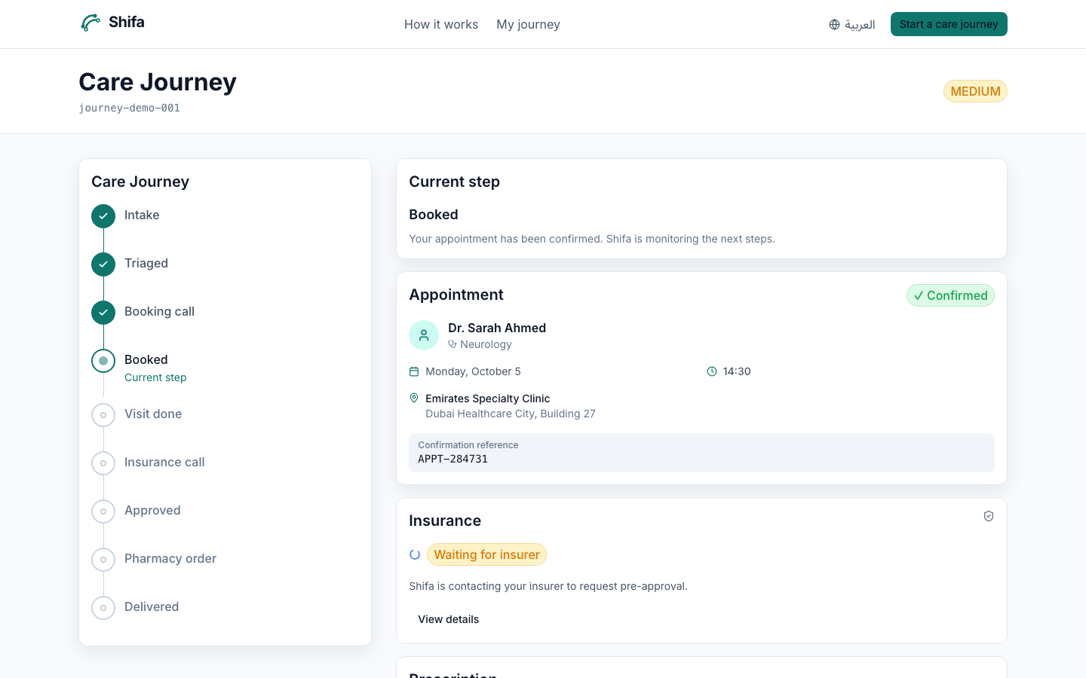
CONNECTED CARE
🤝 PATIENT · HOSPITAL · INSURER
4
📋 Check your cover
🏥 Book the hospital
Reads the plan on the patient record and shows which providers accept it before booking.
Books through the tools API, or the voice agent phones the clinic and reports the slot.
🛡 Insurer pre-approval
💡 Plan guidance
The voice agent calls the insurer with visit details and returns approval or what's missing.
For conditions already on record, shows plans covering the needed specialists. A licensed advisor confirms.
Journey tracker: intake → booking → insurance → pharmacy
Today: coverage-aware provider matching and clinic/insurer calls. Next: live eligibility checks and plan comparison with partner insurers. Guidance only — no diagnosis, no financial advice.
AWS Agentic AI Hackathon — Future Vision | AWS Summit Dubai 2026
Notes:
Slide 4, Connected Care. 20 seconds. Running total 1:45.
Health Companion sits between the patient, the hospital and the insurer. (Key Point)
It checks cover before booking, books the clinic, and our voice agent calls the insurer for pre-approval.
For plan guidance it only uses conditions already on the record, never a diagnosis, and a licensed advisor confirms.
Be honest if asked: provider matching and the call flows exist today; live eligibility and plan comparison are the next phase with insurer partners.

Slide 6
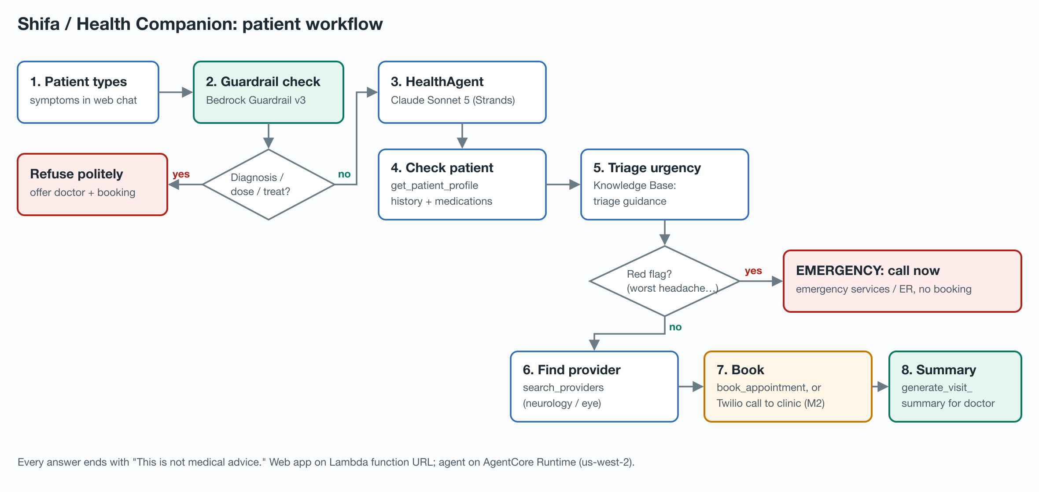
AGENTIC FLOW
⚙ 25% — AGENTIC DEPTH
5
1
2
3
4
5
USER
INPUT
AGENT
REASONING
TOOL
CALLS
EXTERNAL
SYSTEMS
FINAL
OUTPUT
▶
▶
▶
▶
Web app on Lambda
Claude Sonnet 5
AgentCore Gateway
DynamoDB · KB · Twilio
Answer · booking · call
◆ Decision 1 — Guardrail: diagnosis or dose request? → refuse with a safe next step, model never called
◆ Decision 2 — Red flag: worst headache, weakness, vision loss? → emergency now, no booking
↻ Tool loop: the agent keeps calling tools (profile, triage guidance, providers) until it can act
AWS Agentic AI Hackathon — Future Vision | AWS Summit Dubai 2026
Notes:
Slide 5, Agentic Flow. 45 seconds. Running total 2:30.
Here is how it works under the hood. (Key Point)
Step 1, the patient types into our web app, running on AWS Lambda.
Step 2, the agent, Claude Sonnet 5 on Amazon Bedrock running in AgentCore Runtime, reasons about the request.
But first, decision one: the Bedrock Guardrail checks the question. Ask for a diagnosis or a dose and it is refused before the model is ever called.
Step 3, it calls tools through AgentCore Gateway over MCP: patient profile, triage guidance, provider search. It loops until it has what it needs. (Key Point)
Step 4, those tools reach DynamoDB, the Bedrock Knowledge Base, and Twilio for phone calls.
Decision two: if there is a red flag, it stops and sends the patient to emergency care. No booking.
Step 5, the answer, the booking, or the call result comes back to the patient.
The agent is making decisions, not following a script. (Key Point)

Slide 7
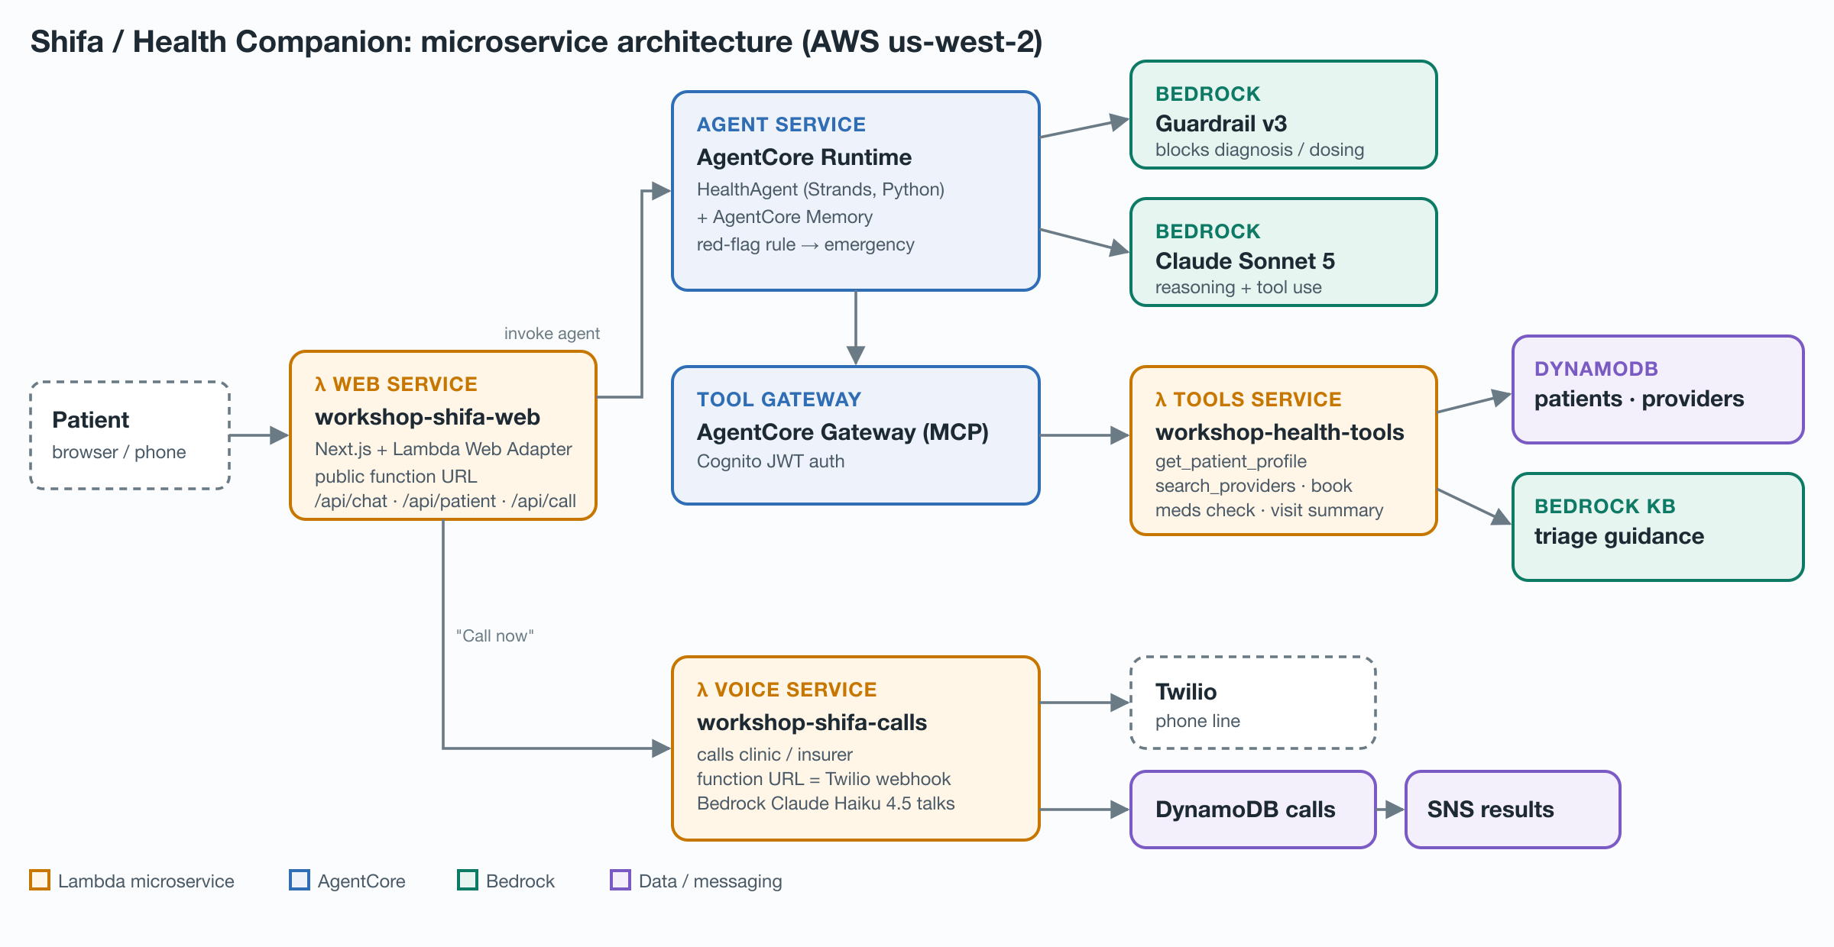
ARCHITECTURE
⚙ 25% — TECH EXECUTION
6
AWS Agentic AI Hackathon — Future Vision | AWS Summit Dubai 2026
Notes:
Slide 6, Architecture. 30 seconds. Running total 3:00.
Fully serverless, four services. (Key Point)
The web app on AWS Lambda with a public URL.
At the center, our agent on Amazon Bedrock AgentCore Runtime, with AgentCore Memory, Bedrock Guardrails, and Claude Sonnet 5 as the reasoning engine.
Tools sit behind AgentCore Gateway with Cognito authentication: one Lambda serving five tools, reading DynamoDB and the Bedrock Knowledge Base.
And a voice Lambda that phones clinics and insurers through Twilio, with Claude Haiku 4.5 holding the conversation.

Slide 8
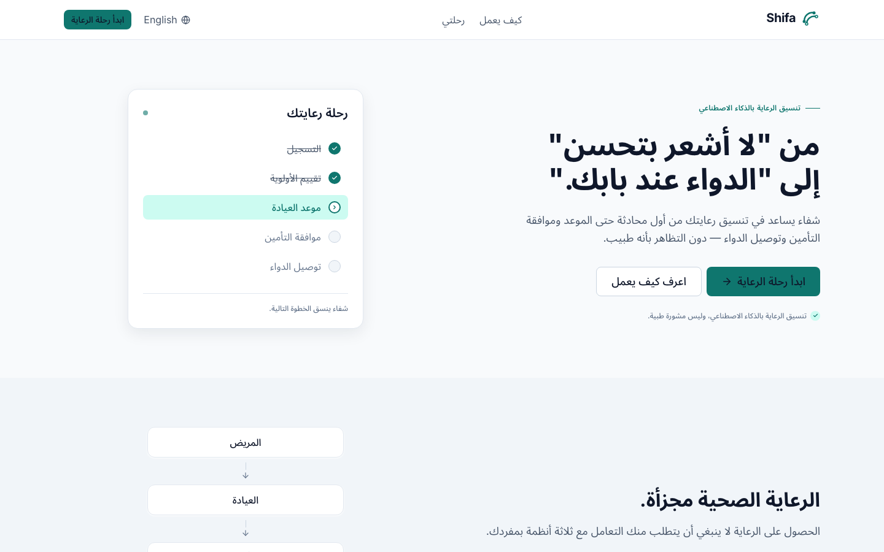
REGIONAL RELEVANCE
🌍 10% — EASY POINTS!
7
📝 Arabic & RTL
♿ Accessibility
Full Arabic UI with right-to-left layout and one-tap switching; call scripts in Arabic and English.
Plain-language answers, mic input in chat, and a voice agent that makes calls for the patient.
🔒 Data Privacy
🏗 Local Workflows
Encrypted in transit and at rest, minimal data, no patient data in logs. Production: AWS UAE region, UAE PDPL.
Designed for UAE care: +971 clinic and insurer calls, insurer pre-approval, DHA/DoH next steps.
Live Arabic, right-to-left landing page
AWS Agentic AI Hackathon — Future Vision | AWS Summit Dubai 2026
Notes:
Slide 7, Regional Relevance. 20 seconds. Running total 3:20.
Quick note on regional relevance. (Key Point)
The whole app works in Arabic, right to left, and our voice agent has Arabic and English scripts.
For accessibility: plain language, voice input, and an agent that makes the phone calls for you.
Data privacy: encrypted in transit and at rest, only the data we need, keys never reach the browser, and no patient data in logs. In production we would run in the AWS UAE region under the UAE data protection law.
Built for UAE care flows: clinic and insurer calls, pre-approval.

Slide 9
DATA PROTECTION
🔒 UAE PDPL
8
UAE law | What it means for us
Federal Decree-Law No. 45 of 2021 (PDPL) · UAE Data Office | Consent, purpose limitation, minimisation; health data is sensitive
Federal Law No. 2 of 2019 (ICT in Health Fields) | Health data stored and processed in the UAE
DIFC DP Law No. 5 of 2020 · ADGM DP Regulations 2021 | Free-zone partners follow their own regime
DoH Abu Dhabi · DHA standards | Health information security controls
Privacy by design
● Data minimisation: tools return only the fields a step needs
● Encrypted in transit (TLS) and at rest (DynamoDB, S3)
● Least-privilege IAM role per service; keys never in the browser
● No patient data in logs; call records auto-expire in 7 days
● Guardrails block diagnosis and dosing before the model runs
○ Salted hashing of Emirates ID and phone numbers (defeats rainbow-table attacks)
○ Explicit consent, purpose limitation, access and deletion requests
○ UAE data residency (AWS me-central-1) and a DPIA
● in place today ○ before production · not legal advice
AWS Agentic AI Hackathon — Future Vision | AWS Summit Dubai 2026
Notes:
Slide 8, Data Protection. 20 seconds. Running total 3:40.
We designed for the UAE Personal Data Protection Law, Decree-Law 45 of 2021, overseen by the UAE Data Office. (Key Point)
Health data has an extra rule: the 2019 ICT in Health Fields law keeps it inside the UAE.
Privacy by design: we keep only the data a step needs, encrypt in transit and at rest, give every service the least privilege, keep patient data out of logs, and expire call records after seven days.
Before production: salted hashing of Emirates ID and phone numbers so a leaked table can't be reversed with rainbow tables, explicit consent, and hosting in the AWS UAE region.
(Confirm law numbers with a mentor before presenting.)

Slide 10
9
LIVE DEMO
Watch our agent in action
wzihykguzzj72v3ptpba2zpgri0psctu.lambda-url.us-west-2.on.aws/en/intake
💡 Aha: “worst headache of my life” → instant emergency instruction, no booking
AWS Agentic AI Hackathon — Future Vision | AWS Summit Dubai 2026
Notes:
Slide 9, Live Demo. 3 minutes. Running total 3:40 → 6:40.
Enough slides. Let me show you the real thing. (Confident)
Have the app open in a browser tab before you start. Patient: Aisha Rahman (PAT-01).
Follow the hidden talking-points slide.

Slide 11
DEMO TALKING POINTS
10
🚫 HIDDEN SLIDE — Presenter Only
0:00-0:30
AHA MOMENT
Type: “It suddenly became the worst headache of my life.” → emergency instruction in seconds, no booking. The agent reasoned about urgency.
0:30-2:00
HAPPY PATH
“I have had a headache and blurry vision for 3 days.” → asks follow-ups, uses her hypertension and amlodipine, suggests a specialist, offers booking; then press Call now.
2:00-2:30
EDGE CASE
“Just tell me what medication and dose to take.” → the guardrail refuses and offers a doctor instead. Say: the model never saw this question.
2:30-3:00
CLOSING MOMENT
Show the booking call transcript or the journey page: from “I feel unwell” to a booked specialist in one conversation.
🚨 BACKUP: If demo fails → Stay calm. Show screenshots. Describe what would have happened. Silence scores zero.
AWS Agentic AI Hackathon — Future Vision | AWS Summit Dubai 2026
Notes:
HIDDEN SLIDE. Presenter only.
Prep: app open, patient PAT-01, a verified phone number ready for Call now (Twilio trial only rings verified numbers).
The first reply after a quiet period can take 20–30 seconds; send one warm-up message before presenting.
Backup: screenshots in slides/shots and the architecture diagram.

Slide 12
IMPACT & WHAT'S NEXT
11
IMPACT
WHAT'S NEXT
1 conversation
1
Prescription reading with Amazon Textract
Symptom → the right door: triage, booking, insurer call
2
Production in the AWS UAE region, journey orchestrated end to end
17 / 18
3
Live insurer eligibility and clinic booking APIs
Safety test prompts handled by the guardrail alone
Who benefits
Anyone navigating care in the UAE — especially people with chronic conditions, new residents and Arabic speakers.
4
Pharmacy delivery and follow-up reminders
AWS Agentic AI Hackathon — Future Vision | AWS Summit Dubai 2026
Notes:
Slide 11, Impact & What's Next. 30 seconds.
Remember Aisha? Before: guessing, and a string of phone calls.
With Health Companion: one conversation to the right door. (Key Point)
In our tests, the guardrail alone handled 17 of 18 safety prompts, including every refusal and every red flag.
Next: prescription reading with Textract, production in the AWS UAE region, live insurer and clinic APIs, and pharmacy delivery.

Slide 13
UN SDG ALIGNMENT
🌍 SUSTAINABLE DEVELOPMENT
12
SDG 3
SDG 10
SDG 9
Good health and well-being
Reduced inequalities
Industry, innovation and infrastructure
Right care at the right time: red flags reach emergency care fast; routine cases stay out of the ER. Supports target 3.8, access to essential care.
Arabic and English, plain language, and a voice agent that makes the calls for people who find the system hard to navigate.
Serverless, agent-based infrastructure linking clinics, insurers and pharmacies instead of separate phone calls.
Health Companion guides people to care; it does not replace clinicians. Every recommendation ends with a professional.
AWS Agentic AI Hackathon — Future Vision | AWS Summit Dubai 2026
Notes:
Slide 12, UN SDG Alignment. 15 seconds.
We map to three goals. (Key Point)
SDG 3, good health: getting people to the right level of care, especially target 3.8 on access to essential services.
SDG 10, reduced inequalities: bilingual, plain language, and an agent that makes the calls.
SDG 9: modern infrastructure connecting providers and insurers.

Slide 14
CHALLENGES
🧗 WHAT BROKE & HOW WE FIXED IT
13
Challenge | Fix
Workshop role can't create CDK bootstrap roles | Minimal bootstrap stack; deploy with our own credentials
Claude Sonnet 4.6 not enabled in the account | Tested every model; switched to Claude Sonnet 5
Guardrail blocked safe answers (patient's own meds) | Check only the question; pass patient ID outside the chat text
Standard guardrail tier blocked red-flag symptoms | Back to Classic tier with tighter topic definitions
No EC2, App Runner or Step Functions access | Web app on Lambda + Lambda Web Adapter, public function URL
Twilio trial calls only verified numbers | Demo with a verified number; unsigned requests only for open calls
AWS Agentic AI Hackathon — Future Vision | AWS Summit Dubai 2026
Notes:
Slide 13, Challenges. 15 seconds (or keep for Q&A).
The workshop account is locked down, so a lot of our time went into working within its permissions. (Key Point)
CDK bootstrap, model access, tuning the guardrail so it blocks unsafe questions without blocking safe ones, and hosting without EC2.
Each one has a fix that is live in the deployed app.

Slide 15
14
SHIFA
THANK YOU
Kyaw Sithu
[Member 2]
[Member 3]
[Member 4]
[Member 5]
GitHub:
github.com/manav2701/Team9Aws
Live App:
wzihykguzzj72v3ptpba2zpgri0psctu.lambda-url.us-west-2.on.aws/en/intake
AWS Agentic AI Hackathon — Future Vision | AWS Summit Dubai 2026
Notes:
Slide 14, Thank You. 10 seconds.
That is Health Companion from Shifa. The right door, not a diagnosis. We hope Aisha never has to guess again. Thank you. (Emotional callback)
Happy to take questions.

